Slide 1

Agile Presentation
Corvinna Curtis
CS250: SDLC
11 October 2023

Slide 2

Introduction to Agile and Scrum
Agile is a flexible and iterative approach to software development.
Scrum is a framework within Agile that emphasizes teamwork, accountability, and iterative progress
Notes:
Navigating through the dynamic world of software development with Agile and Scrum, enhancing adaptability and customer-centric delivery.

Slide 3
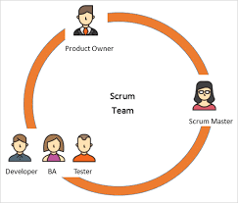
Roles in a Scrum-Agile Team
Scrum Master: Ensure adherence to Scrum Practices, facilitates meetings, and removes impediments
Product Owner: Manages the product backlog, user stories, and serves as a liaison between stakeholders
Development Team: Cross-function team who work to deliver increments of the product
Notes:
Scrum Master: "Ensures the team follows Scrum processes, addresses impediments, and fosters a collaborative environment."
Product Owner: "Defines product features, prioritizes work based on business value, and acts as the voice of the customer."
Development Team: "Cross-functional professionals responsible for delivering potentially shippable increments each sprint."

Slide 4
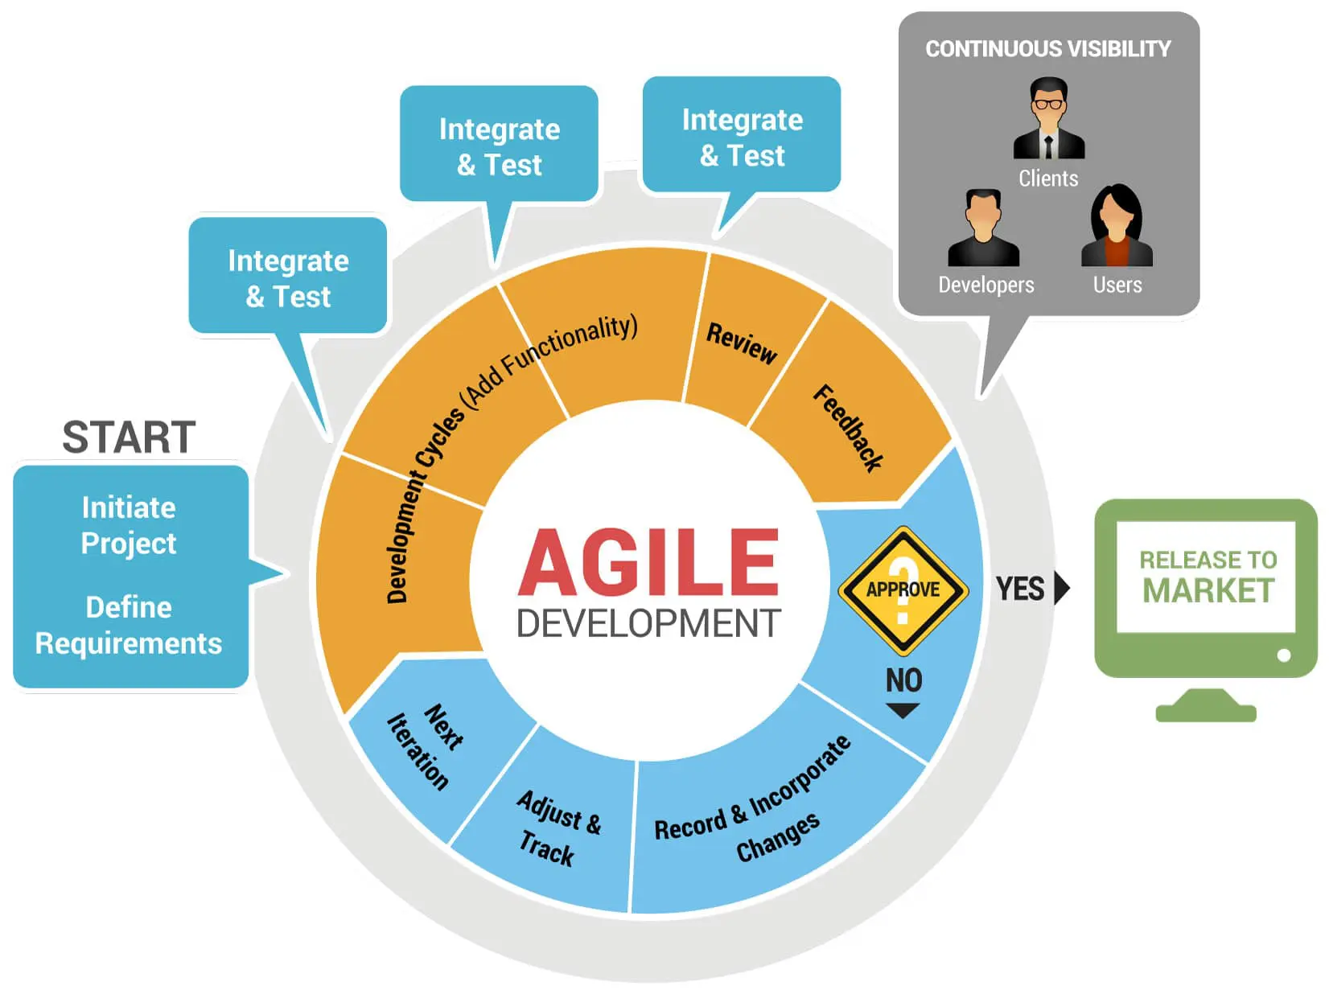
Agile Software Development Life Cycle (SDLC)
Planning: Identify requirements and create a product backlog.
Design: Craft a technical solution for selected backlog items.
Development: Code, test, and integrate new features.
Testing: Ensure quality and functionality meet requirements.
Deployment: Release the increment to production.
Review: Reflect on the sprint, gather feedback, and improve.
Notes:
Planning: Identifying scope, establishing the backlog, and defining user stories.
Design: Crafting a user-friendly and practical design, considering both UI/UX.
Development: Incrementally developing the product, focusing on high-priority items in the backlog.
Testing: Continuous testing throughout development to ensure robustness and adherence to requirements.
Deployment: Releasing increments of the product to users.
Review: Assessing the product and process and incorporating feedback into the next cycle.

Slide 5
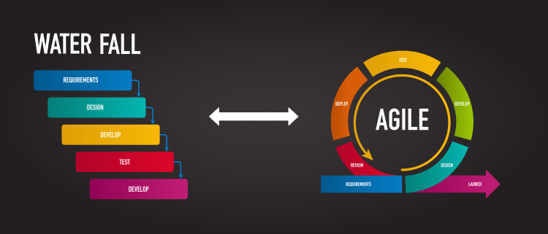
Agile vs. Waterfall Methodologies
Agile promotes iterative development and feedback, allowing for changes in scope and direction.
Waterfall follows a strict sequence from requirements to deployment, with little room for changes.
For instance, the GUI color scheme issue would have been challenging to change late in a Waterfall project but was addressed in a subsequent sprint in Agile.
Notes:
Agile emphasizes iterative development and flexibility, allowing for changes and evolution throughout the project, as seen with the GUI color adjustment.
Waterfall, being linear and phase-dependent, would not accommodate changes without significant setbacks and modifications to the initial plan, making GUI alterations complex and time-consuming.

Slide 6
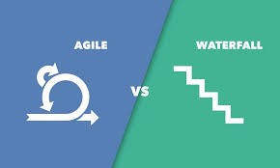
Choosing Between Agile and Waterfall
Consider the stability of requirements. Agile thrives in change, while Waterfall requires a clear, stable path.
Consider the project's size and complexity. Large, well-defined projects may benefit from Waterfall's structure, while smaller, evolving projects might favor Agile.
Reflecting on our challenges, like blurry image resolution, Agile allowed quick iterations and solutions, while in Waterfall, it might have been a prolonged issue until the next release.
Notes:
Factors such as the stability of requirements, customer involvement, and project complexity influence the choice between Agile and Waterfall.
The GUI color and blurry image issues in our project were swiftly handled due to Agile's adaptability, which might not have been the case with Waterfall, demonstrating Agile’s practicality in projects requiring flexibility and iterative refinement.

Slide 7

Reflection and Forward Path
Agile's flexibility was invaluable in navigating challenges and ensuring a quality product.
The roles within Scrum provided clear responsibilities and fostered collaboration.
Considering our success, adopting Agile across the organization could enhance product quality and team dynamics.
Notes:
Through embracing Agile, the team was able to navigate through challenges and adapt to changes effectively, as evidenced by the iterative improvements made to the GUI and image clarity.
Moving forward, embracing Agile methodologies across teams may enhance adaptability, customer satisfaction, and project success.

Slide 8

References
Schwaber, K., & Sutherland, J. (2017). The Scrum Guide. ScrumGuides.org.
Larman, C., & Vodde, B. (2008). Scaling lean & agile development: Thinking and organizational tools for large-scale Scrum.

Slide 9
Thank You
Corvinna Curtis
Corvinna.Curtis@snhu.edu

